Slide 1
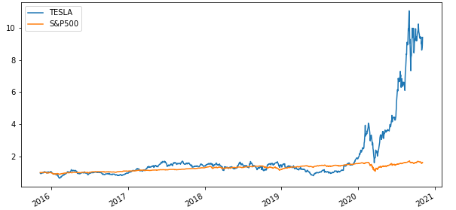

YOUR NEXT INVESTMENT Why Not Tesla ?
2020.11
Team Members: Minh Tran, Syed Naqvi, Rodrigo Guazzelli, Hsuan Liu, Abdullah Mamun

Slide 2

Data Sources
Growing Industry
Market size, CAGR of EV market, Yearly sales of EV
1
Diversification Effect
TSLA revenue breakdown by segment and region
2
3
Financial
TSLA Net Income, EBITDA, Profitability, Capex
Valuation comparable model
4
Stock Price Performance and Simulation
2015-2020 stock price of TSLA, S&P500, main competitor Monte Carlo simulation for the next 20 years
5
Sources
Capital IQ, Factset, TSLA Investor Relation, NREL, Yahoo Finance, Bloomberg, Wood Mackenzie
2
Notes:
Capital IQ, Factset, TSLA Investor Relation, Yahoo Finance, Bloomberg, Wood Mackenzie, NREL

Slide 3









Data Exploration and Cleanup Process
Import Library
Import Data
Drop Nulls, Comma
With CSV
Complete Dataframe
Rename Columns/ Index
Covert to Float
Slice Data
Graphs
Raw Data
Without CSV
API
Setup & Verify ENV
Define & Select Variables
Import Library
Complete Dataframe
Manually Input Data
Read Data
Verify Datatype & Info
Graphs
Capital IQ
Factset
TSLA Investor Relation
Yahoo Finance
Alpaca API
Bloomberg
Wood Mackenzie
NREL
IBIS World
Existing Library
Path, Os, requests
alpaca_trade_api, load_dotenv
Panel, hvplot.pandas, plotly.express
Pandas, Numpy
MCSimulation
New Library
Holoviews
yfinance
Data Sources
Library
Notes:
10k, combine data manually,
Verify

Slide 4


EV Market Outbreaks from 2020 to 2040
2020
2025
Current Status – On Road
500,000 e-buses
400,000 electric delivery vans
and trucks
184M electric mopeds, scooters
and motorcycles
Charging Units –
North America and Europe
500,000 charger units in 2022
Reach over 1.25 million by 2025
Passengers
Reach 10% EV sales
for lobal passenger in 2025
4
Source ：Bloomberg, Wood Mackenzie, NREL

Slide 5

EV Market Outbreaks from 2020 to 2040
2030
2040
EV Impact –
Americans Private Households Income
Each saves $ 255 to $791 per year
Total private benefits range from
$18.6 to $27.3 billion by 2035
for main aggressive & low-cost scenarios
Expected EV Status
500 million EV passenger on the road
31% world's passenger cars are electric
Passengers.
Increase by 58 globally
Passengers
Increase by 28% in 2030 globally
Green Hydrogen Costs
Fall by up to 64%
5
Source ：Bloomberg, Wood Mackenzie, NREL

Slide 6
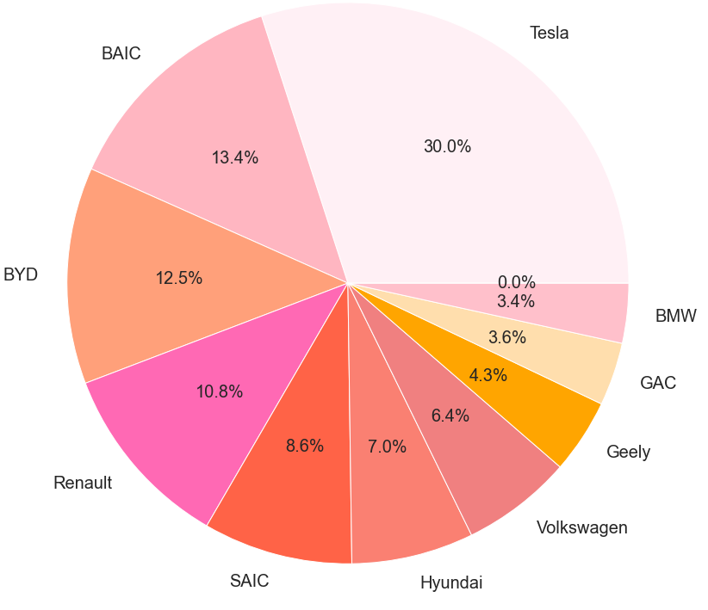
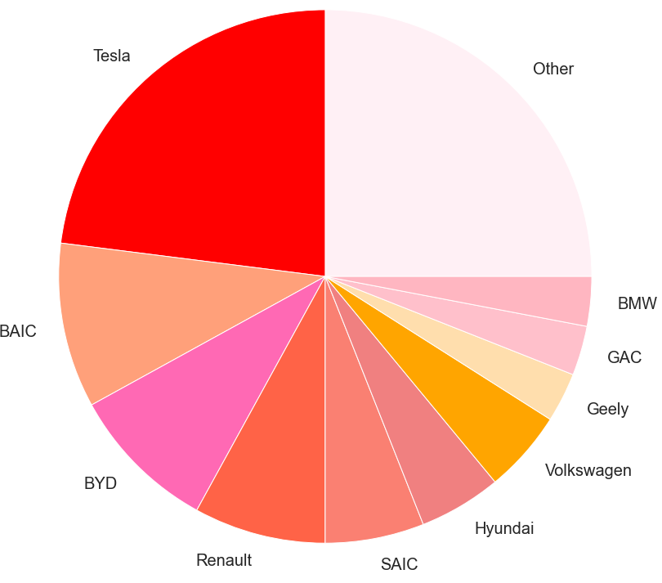
EV Market Snapshot in 2019 – TSLA leading in both sale and market share
Top 10 EV Automotive Makers by Sales in 2019
Market Share of All-electric Car in 2019
25%
6
Source ：IBIS World, Deloitte EV Market Report, Industry Report
Notes:
TEV/Total Revenues LTM – Latest 14.3
TEV/EBITDA LTM – Latest 90.8
Industry 50th percentile
TEV/Total Revenues LTM - Latest 1.2 TEV/EBITDA LTM - Latest 16.6

Slide 7
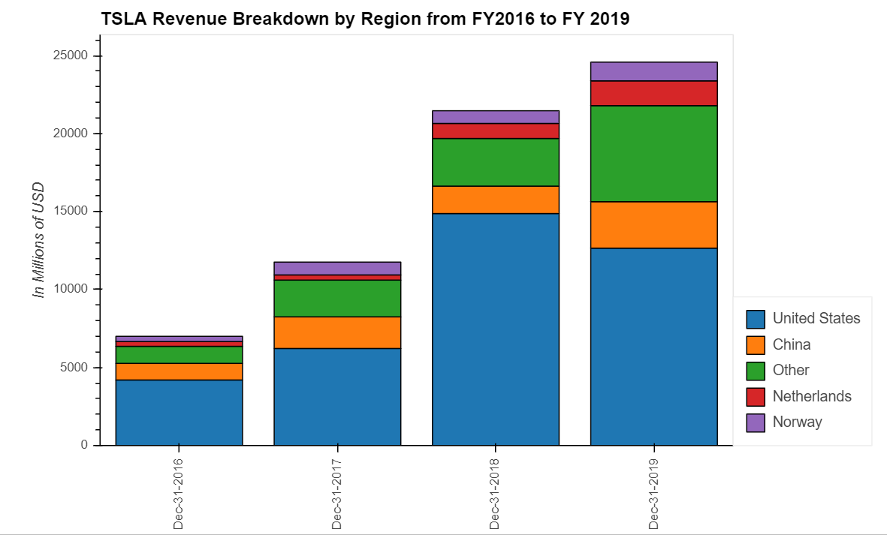
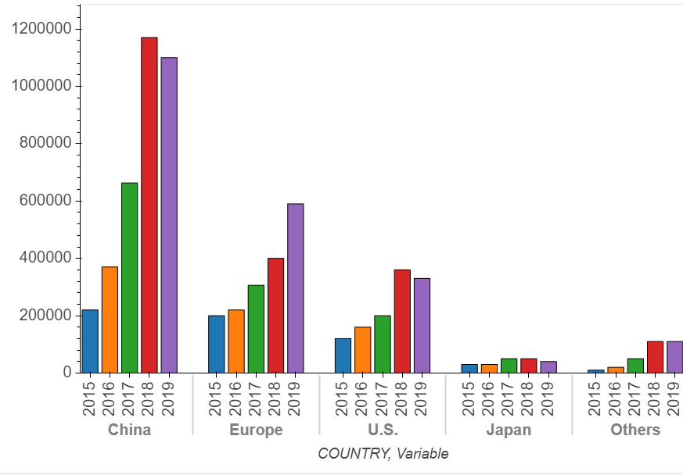
TSLA-Business Diversification
Global EV Sales from 2015 to 2019
TSLA Revenue Breakdown by Region
25%
TSLA has focused on global expansion in China, Netherland, and Norway market
Netherland and Norway - effective policy of reducing air pollution
China - the world's biggest car market
7
Source ：Industry Report, Equity Research Report,

Slide 8
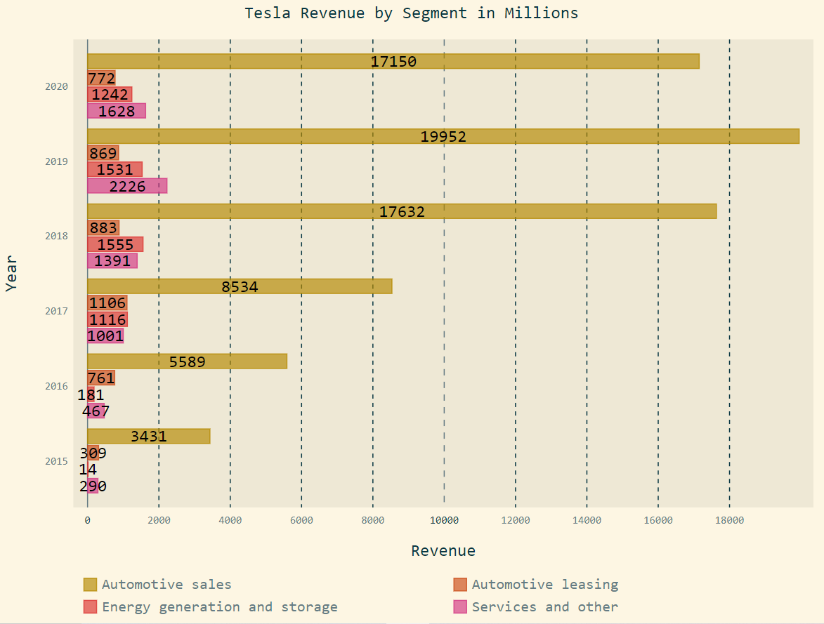
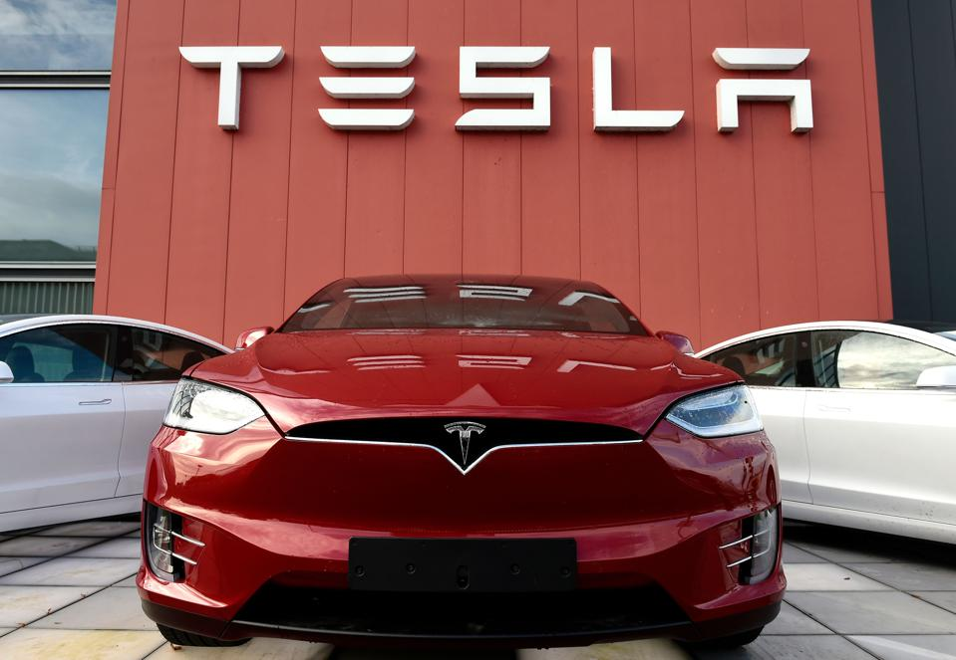
TSLA-Business Diversification
Revenue Breakdown by Segment
Tesla Possible Future Incomes
In-house car insurance
Robo-taxi
Ride-hailing Vehicles and Services
FSD & Software as a service
Industry batteries
Computer chips for FSD
8
Source ：TSLA Investor Relation

Slide 9
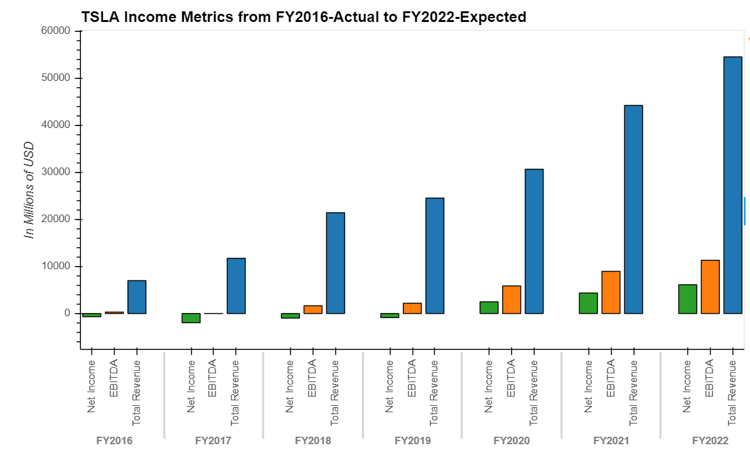
TSLA-Financial Analysis
Income Metrics- Net Income, EBITDA, Revenue
Profitability
Revenue CAGR 36.89% from FY2016 to 2019
EBITDA CAGR 64.12% from FY2016 to 2019
Net Income has turned positive in FY2020
Capex growth trend with cumulative 12 months YoY of 94.62% to $ 2,423 M as of Sep 30 2020
Average Capex from FY2016 to 2020 LTM is $2,237.4 M
Revenue CAGR 36.89%
EBITDA CAGR 64.12%
9
Source ：FactSet, Equity Research Report, FS
Notes:
(1,634.9) (1,440.5) (4,081.0) (2,319.0) (1,432.0)

Slide 10
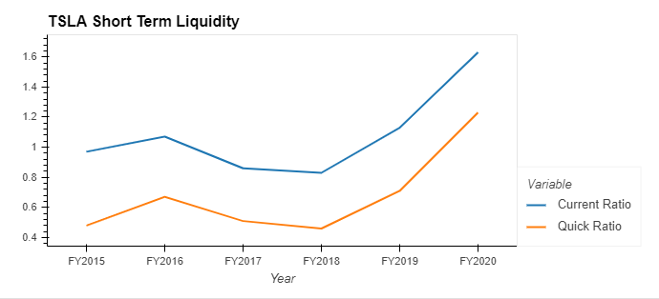
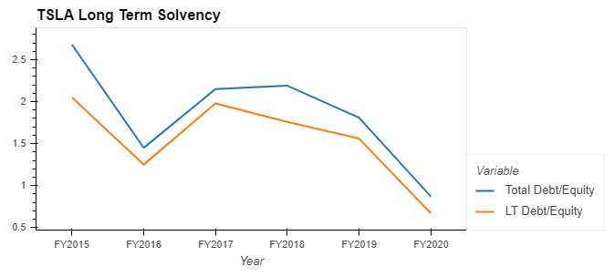
TSLA-Financial Analysis
Short-term Liquidity Analysis
Long-term Solvency
Current and quick ratio trend up, indicating TSLA’s ability to meet short-term liabilities with short-term assets
Leverage of TLSA has a down trend and the likelihood of default has been decreasing
10
Source ： CapitalIQ, FS

Slide 11
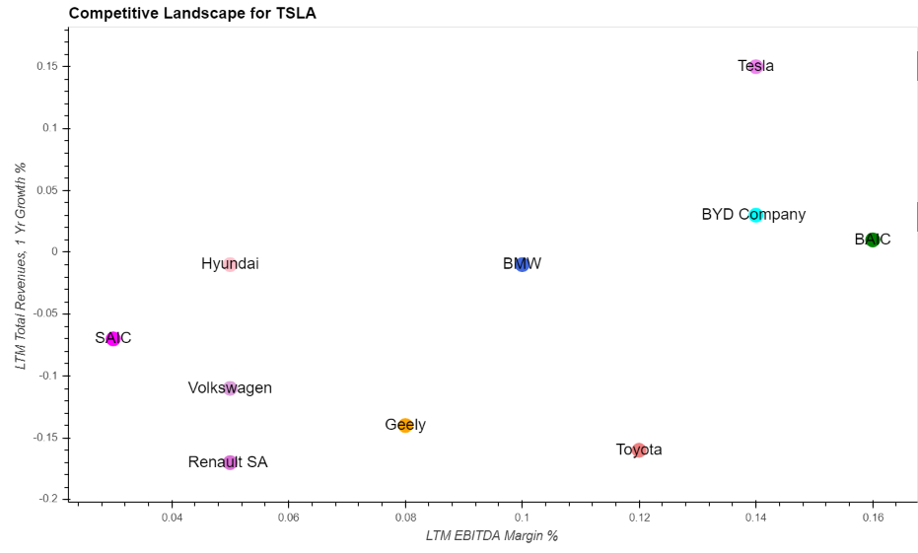
TSLA-Competitive Landscape
First Tier Company - TSLA
Selected Competitors
Toyota
BMW
BAIC
Volkswagen
BYD Company
SAIC
Renault SA
Hyundai
Geely
Tesla
X
Industry Median
Highlights
TSLA has EBITDA margin around 14% and revenue YoY of 15%, serving as an industry leader
Compared to industry median of 9% EBITDA Margin and -4% 1-year Revenues Growth, TSLA becomes competitive - first tier candidate
11
Source ：CapitalIQ, Equity Research Report, FS
Notes:
https://insideevs.com/news/396714/world-top-10-plugin-automotive-groups-2019/
Toyota
BMW
BAIC
Volkswagen
BYD Company
SAIC
Renault SA
Hyundai
Geely
Tesla

Slide 12
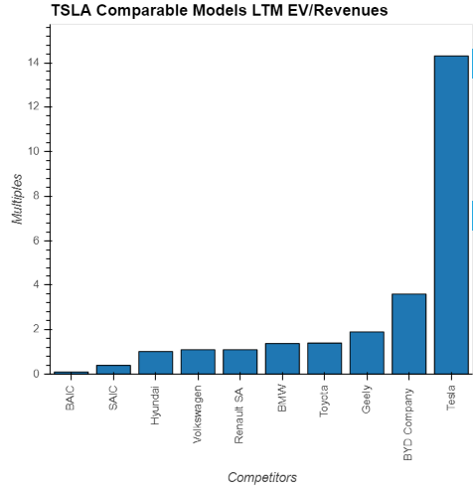
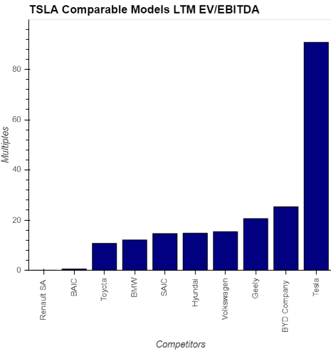
TSLA-Comparable Models
Valuation Highlights - EV/Revenues LTM is 14.3x
Valuation Highlights - EV/EBITDA LTM is 90.8x
Industry Median:1.24x
Industry Median:14.70x
12
Source ：CapitalIQ, Equity Research Report, FS
Notes:
TEV/Total Revenues LTM – Latest 14.3
TEV/EBITDA LTM – Latest 90.8
Industry 50th percentile
TEV/Total Revenues LTM - Latest 1.2 TEV/EBITDA LTM - Latest 16.6

Slide 13
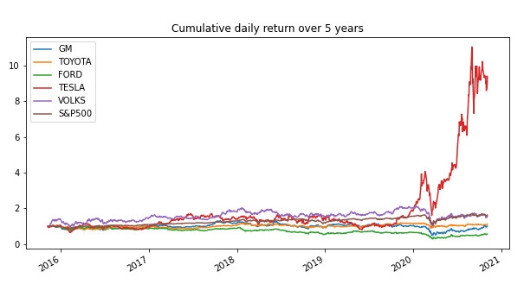
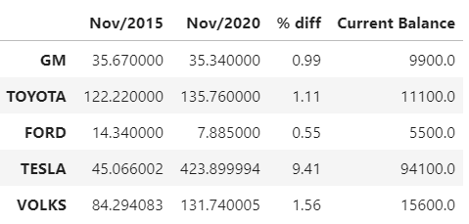
TSLA-Historical Price Analysis For The Last 5 Years
TSLA vs Automaker Competitors
Stock Price of TSLA & Automaker Competitors
If you had invested $10,000 in TESLA stock 5 years ago your current balance would be $94,100
13
Source ：Alpaca trade API / Yahoo Finance
Notes:
TEV/Total Revenues LTM – Latest 14.3
TEV/EBITDA LTM – Latest 90.8
Industry 50th percentile
TEV/Total Revenues LTM - Latest 1.2 TEV/EBITDA LTM - Latest 16.6

Slide 14
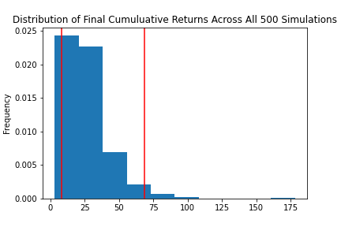
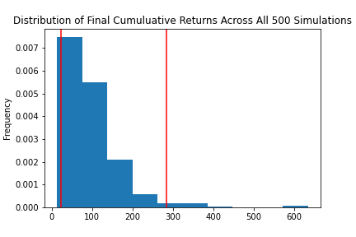
TSLA-Sensitivity Analysis For The Next 20 Years
Monte Carlo Simulation Portfolio Without Tesla
Monte Carlo Simulation Portfolio With Tesla
With an initial investment of $10,000 in your portfolio you have a 95% chance it will be within the range of $82,972.21 and $683,666.61 over the next 20 years
With an initial investment of $10,000 in your portfolio you have a 95% chance it will be within in the range of $226,781.95 and $2,835,449.51 over the next 20 years
Portfolio = Apple, Alphabet, Johnson & Johnson, Berkshire Hathaway
14
Notes:
TEV/Total Revenues LTM – Latest 14.3
TEV/EBITDA LTM – Latest 90.8
Industry 50th percentile
TEV/Total Revenues LTM - Latest 1.2 TEV/EBITDA LTM - Latest 16.6

Slide 15
Conclusion – Investment Thesis Recap
Give TSLA a BUY rating with a 5-year target price
Essential to re-evaluate financial health evert 5 years
1
Growing Industry
Leader in US (25%) and China of all-electric car market, pioneer in EU market
Diversification Effect
Operation in diversified segments and regions with potential technology edges
2
3
Financial
Quality growth led to 64% EBITDA CAGR
Strong performance with LTM EV/EBITDA 90.8x as opposed to industry median of 14.7x
Stock Price Performance and Simulation
95% possibility to earn over $200K with $10K current investment
4
15
Notes:
Growing Industry
Room for growth
Long tesla for the next 5 years investment horizon, re-evaluate every 5 years
Give TSLA a BUY rating with a 5-year target price and it is
equally essential to re-evaluate financial health every 5 years

Slide 16

Q&A Session
16

